Slide 1
Denial of Service Attacks
Internet Censorship and Online Speech
Nick Feamster University of Chicago
Notes:
Assignment 2: Wednesday
Midterm: October 24 (will cover material through this week)
Wednesday’s lecture: Recorded. Extra office hour TBD (Friday afternoon)

Slide 2
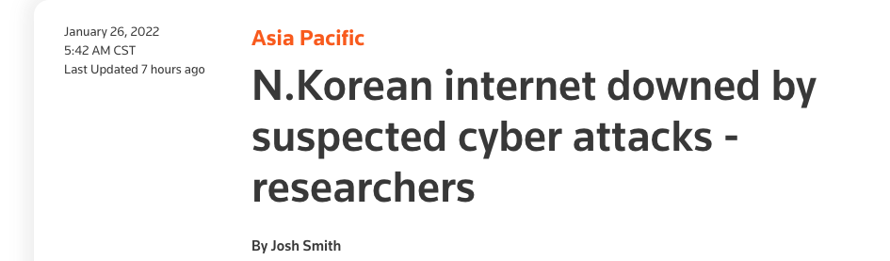
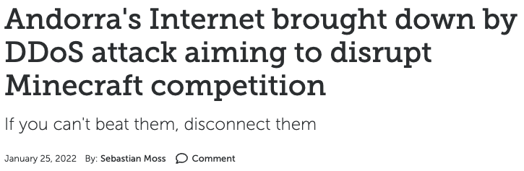
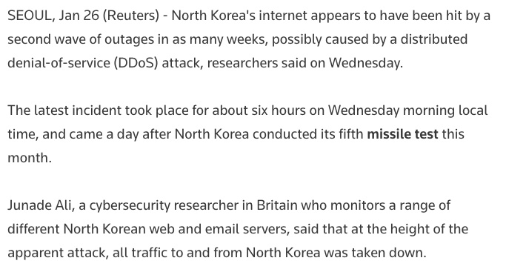
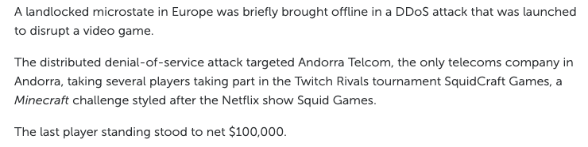
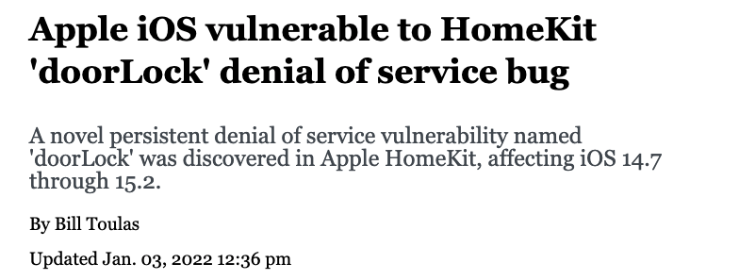
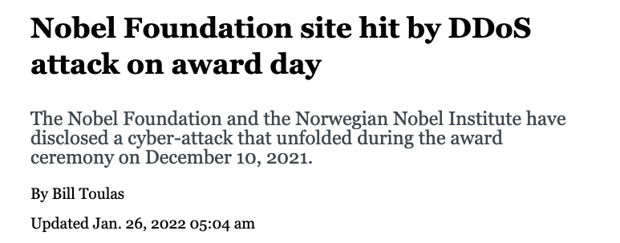
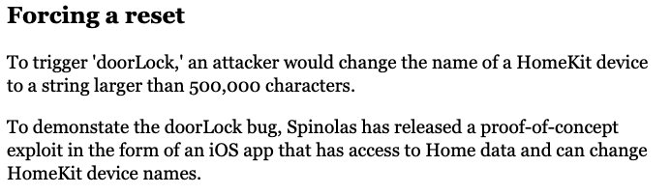

Slide 3


Slide 4
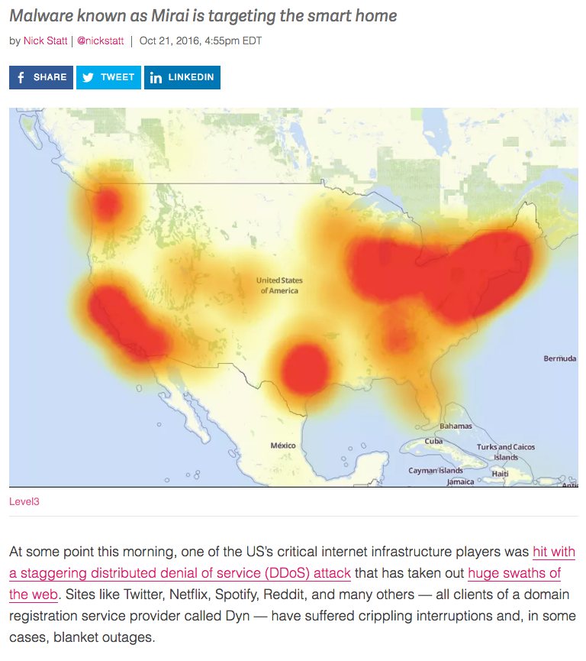
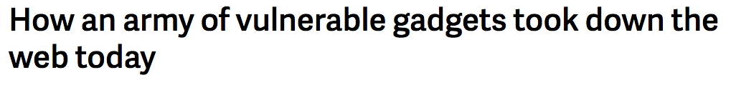
IoT-Based Botnets (More on Botnets Soon…)

Slide 5
Mirai DDoS Post-Mortem
“During a DDoS which uses the DNS protocol it can be difficult to distinguish legitimate traffic from attack traffic. For example, the impact of the attack generated a storm of legitimate retry activity as recursive servers attempted to refresh their caches, creating 10-20X normal traffic volume across a large number of IP addresses. When DNS traffic congestion occurs, legitimate retries can further contribute to traffic volume.
We saw both attack and legitimate traffic coming from millions of IPs across all geographies. It appears the malicious attacks were sourced from at least one botnet, with the retry storm providing a false indicator of a significantly larger set of endpoints than we now know it to be. We are still working on analyzing the data but the estimate at the time of this report is up to 100,000 malicious endpoints. We are able to confirm that a significant volume of attack traffic originated from Mirai-based botnets.

Slide 6
Denial of Service: What is it?
Attacker
Victim
Attempt to exhaust resources
Network: Bandwidth
Transport: TCP connections
Application: Server resources
Typically high-rate attacks, but not always

Slide 7
Targets of Attack
End hosts
Critical servers (disrupt C/S network)
Web, File, Authentication, Update
DNS
Infrastructure
Routers within org
All routers in upstream path
Notes:
----- Meeting Notes (11/14/16 11:29) -----
Cisco DoS vulnerability

Slide 8
Denial of Service: Common Themes
Asymmetry
Reflection and Amplification
Botnets
Difficulty of distinguishing legitimate traffic from attack traffic
(Often) Spoofing of IP addresses

Slide 9
Early Denial of Service
DoS Tools
Single-source, single target tools
IP source address spoofing
Packet amplification (e.g., smurf)
Deployment
Widespread scanning and exploitation via scripted tools
Hand-installed tools and toolkits on compromised hosts (unix)
Use
Hand executed on source host

Slide 10
Basic Amplification Attack
1. ICMP Echo Request Src: DoS Target
Dest: broadcast address
3 ICMP Echo Reply Dest: Dos Target
Send ping request to broadcast address (ICMP Echo Req)
Lots of responses:
Every host on target network generates a ping reply (ICMP Echo Reply) to victim
Network switch
DoS Target
DoS Source

Slide 11
Transmission Control Protocol (TCP)

Slide 12
TCP SYN Flooding Attack
90% of DoS attacks use TCP SYN floods
Streaming spoofed TCP SYNs
Takes advantage of three way handshake
Server start “half-open” connections
These build up… until queue is full and all additional requests are blocked

Slide 13
TCP Connection Management
Three way handshake:
Step 1: client host sends TCP SYN segment to server
specifies initial seq #
no data
Step 2: server host receives SYN, replies with SYNACK segment
server allocates buffers
specifies server initial seq. #
Step 3: client receives SYNACK, replies with ACK segment, which may contain data
Recall: TCP sender, receiver establish “connection” before exchanging data segments
initialize TCP variables:
seq. #s
buffers, flow control info (e.g., RcvWindow)
client: connection initiator
server: contacted by client

Slide 14
TCP: 3-Way Handshake
C
S
SYN_{C}
Listening
Store data
SYN_{S}, ACK_{C}
Wait
ACK_{S}
Connected

Slide 15
TCP Handshake
Each arriving SYN stores state at the server
TCP Control Block (TCB)
~ 280 bytes
FlowID, timer info, Sequence number, flow control status, out-of-band data, MSS, other options agreed to
Half-open TCB entries exist until timeout
Fixed bound on half-open connections
Resources exhausted ⇒ requests rejected

Slide 16
TCP SYN Flooding
Problem: No client authentication of packets before resources allocated
Attacker sends many connection requests
Spoofed source addresses
RSTs quickly generated if source address exists
No reply for non-existent sources
Attacker exhausts TCP buffer to w/ half-open connections

Slide 17
SYN Flooding
C
S
SYN_{C1}
Listening
SYN_{C2}
Store data
SYN_{C3}
SYN_{C4}
SYN_{C5}

Slide 18
A Classic SYN Flood Example
MS Blaster (2003)
Infected machines at noon on Aug 16th:
SYN flood on port 80 to windowsupdate.com
50 SYN packets every second.
each packet is 40 bytes.
Spoofed source IP: a.b.X.Y where X,Y random.
Defense
new name: windowsupdate.microsoft.com
Win update file delivered by Akamai
Notes:
Infected IP: a.b.c.d. a.b.X.Y avoids ingress filtering ISPs. Note: evades Savage’s /8 backscatter monitor.

Slide 19
Domain Name System (DNS)

Slide 20
DNS DoS Attacks
DNS runs on UDP port 53
DNS entry for victim.com hosted at victim_isp.com
DDoS attack:
flood victim_isp.com with requests for victim.com
Random source IP address in UDP packets
Takes out entire DNS server: (collateral damage)
bluesecurity DNS hosted at Tucows DNS server
DNS DDoS took out Tucows hosting many many sites
Notes:
TLD DNS servers: each root server on 200 machines. Requests use IP any cast.

Slide 21
Root Level DNS Attacks
Feb. 6, 2007:
Botnet attack on the 13 Internet DNS root servers
Lasted 2.5 hours
None crashed, but two performed badly:
g-root (DoD), l-root (ICANN)
Most other root servers use anycast
Notes:
Root servers specify where the TLDs are (.com, .net, …)
f-root is supported by 42 different locations.
Only one root server is sufficient to make the Internet work.

Slide 22
DNS Amplification (Common Today)
DNS Amplification attack: ( ×40 amplification )
DNS Query SrcIP: Dos Target
(60 bytes)
EDNS Reponse
(3000 bytes)
DoS Source
DNS Server
DoS Target
Prevention: reject DNS queries from external addresses
Notes:
Other measurements: (MeasurementFactory):
There are an estimated 7.5 million external DNS servers on the public Internet. Over 75% of domain
name servers (of roughly 1.3 million sampled) allow recursive name service to arbitrary queriers.

Slide 23
DoS of SSL/TLS
SSL/TLS handshake [SD’03]
RSA-encrypt speed ≈ 10× RSA-decrypt speed
⇒ Single machine can bring down ten web servers
Similar problem with application DoS:
Send HTTP request for some large PDF file
⇒ Easy work for client, hard work for server.
Client Hello
Web
Server
Server Hello (pub-key)
RSA
Encrypt
Client key exchange
RSA
Decrypt

Slide 24
Defenses

Slide 25
Mirai DDoS: Defenses
Traffic shaping
Rebalancing traffic across load-balanced services
Third-party scrubbing services

Slide 26
Defense: Ingress Filtering
Drop all packets with source address other than 204.69.207.0/24
Internet
204.69.207.0/24
RFC 2827: Routers install filters to drop packets from networks that are not downstream
Feasible at edges
Difficult to configure closer to network “core”

Slide 27
Preventing Denial of Service
DoS is caused by asymmetric state allocation
If responder opens new state for each connection attempt, attacker can initiate thousands of connections from bogus or forged IP addresses
Cookies ensure that the responder is stateless until initiator produced at least two messages
Responder’s state (IP addresses and ports of the connection) is stored in a cookie and sent to initiator
After initiator responds, cookie is regenerated and compared with the cookie returned by the initiator

Slide 28
Defense: TCP SYN cookies
General idea
Client sends SYN w/ ACK number
Server responds to Client with SYN-ACK cookie
sqn = f(src addr, src port, dest addr, dest port, rand)
Server does not save state
Honest client responds with ACK(sqn)
Server checks response
If matches SYN-ACK, establishes connection

Slide 29
TCP SYN cookie
TCP SYN/ACK seqno encodes a cookie
32-bit sequence number
t mod 32: counter to ensure sequence numbers increase every 64 seconds
MSS: encoding of server MSS (can only have 8 settings)
Cookie: easy to create and validate, hard to forge
Includes timestamp, nonce, 4-tuple
32
0
t mod 32
MSS
Cookie=HMAC(t, N_{s}, SIP, SPort, DIP, DPort)
5 bits
3 bits

Slide 30
SYN Cookies
client
sends SYN packet and ACK number to server
waits for SYN-ACK from server w/ matching ACK number
server
responds w/ SYN-ACK packet w/ initial SYN-cookie sequence number
Sequence number is cryptographically generated value based on client address, port, and time.
client
sends ACK to server w/ matching sequence number
server
If ACK is to an unopened socket, server validates returned sequence number as SYN-cookie
If value is reasonable, a buffer is allocated and socket is opened
SYN
ack-number
SYN-ACK
seq-number as SYN-cookie,
ack-number
NO BUFFER ALLOCATED
ACK
seq_number
ack-number+data
SYN-ACK
seq-number, ack-number
TCP BUFFER ALLOCATED

Slide 31
Defense: uRPF Checks
Accept packet from interface only if forwarding table entry for source IP address matches ingress interface
Strict Mode
uRPF Enabled
10.0.18.3 from wrong interface
“A” Routing Table
Destination Next Hop
10.0.1.0/24 Int. 1
10.0.18.0/24 Int. 2
Unicast Reverse Path Forwarding
Cisco: “ip verify unicast reverse-path”
Requires symmetric routing

Slide 32
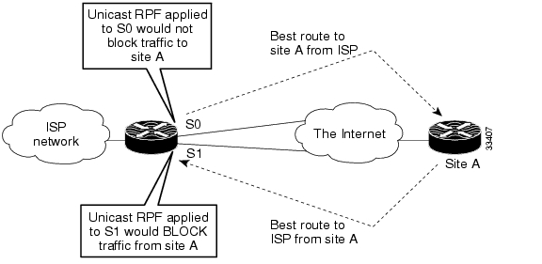
Problems with uRPF
Asymmetric routing…

Slide 33
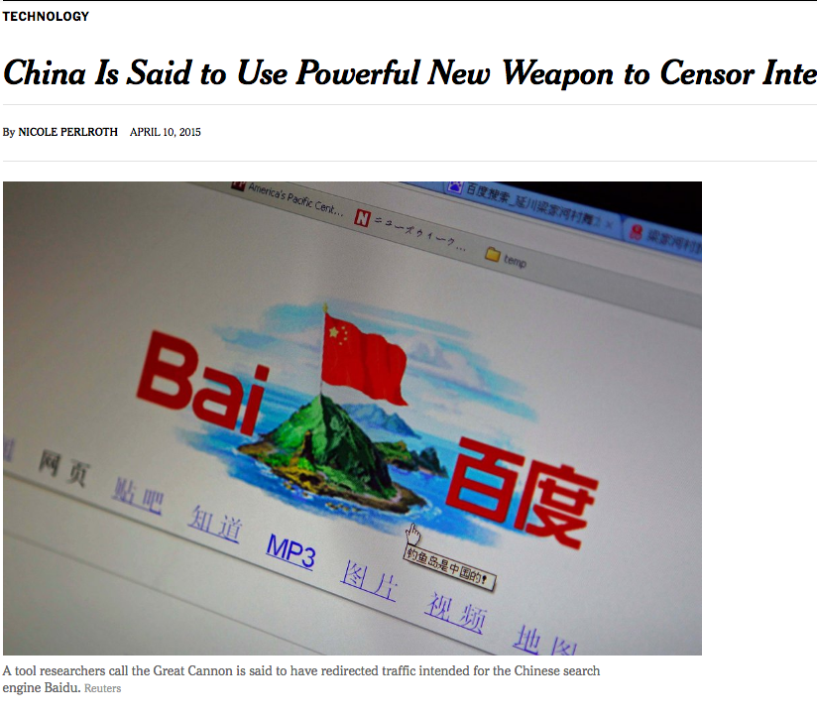
China’s Great Cannon
March 26, 2016: Github pages run by Greatfire.org are victims of DoS attack
Malicious traffic directed from Baidu servers
Baidu said that their servers were not compromised…
Instead: Traffic manipulation of “bystander” systems (i.e., client browsers)

Slide 34
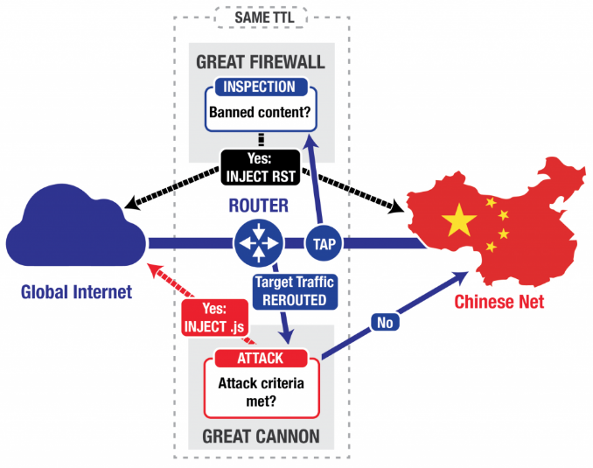
“On-Path” Attack System
Eavesdrop traffic between China & rest of world
Terminate requests for banned content with TCP RST
Appears to be co-located with the “Great Firewall”, load-balanced
Differences: probabilistic, no packet reassembly

Slide 35
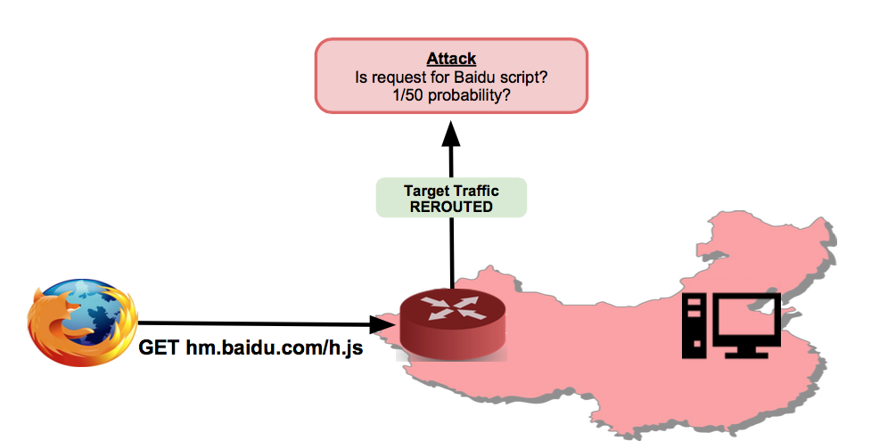
China’s “Great Cannon”

Slide 36
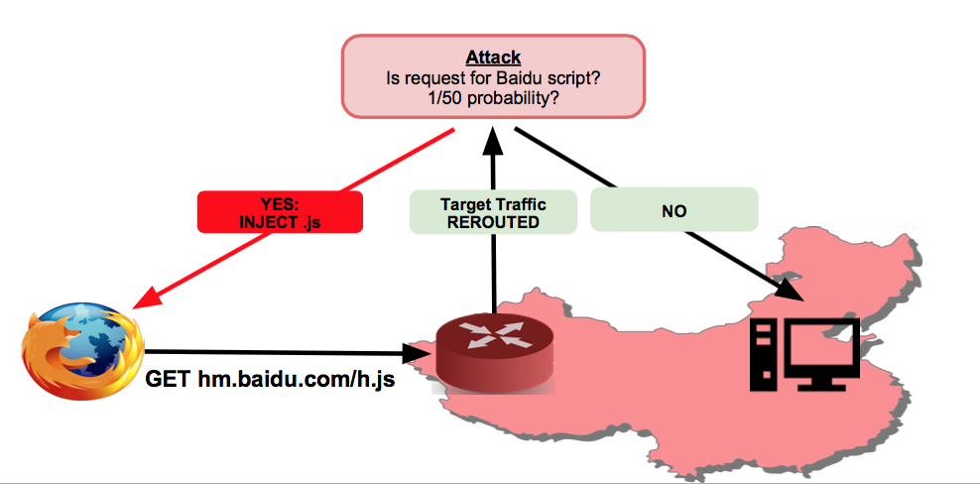
Great Cannon: Inject Javascript

Slide 37
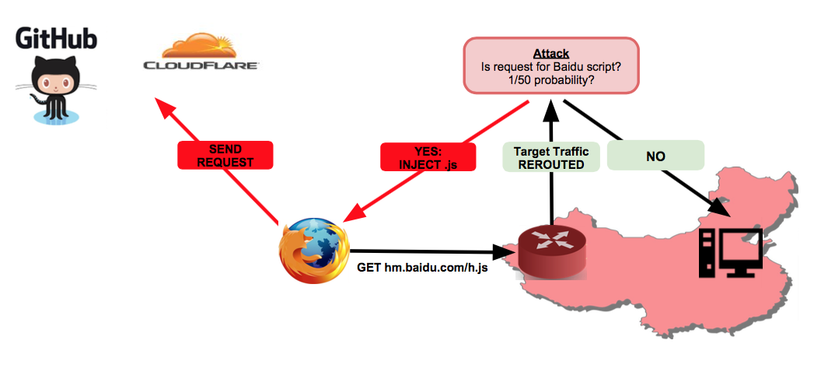
Great Cannon: Direct HTTP at Victim

Slide 38
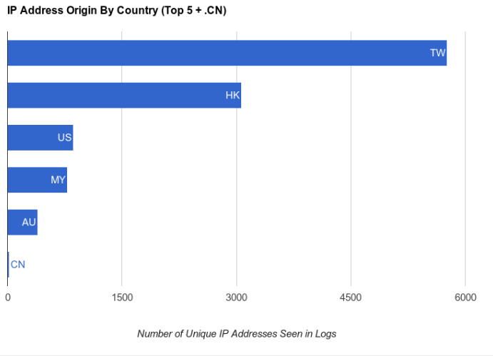
Where Were the Attacking Clients?

Slide 39
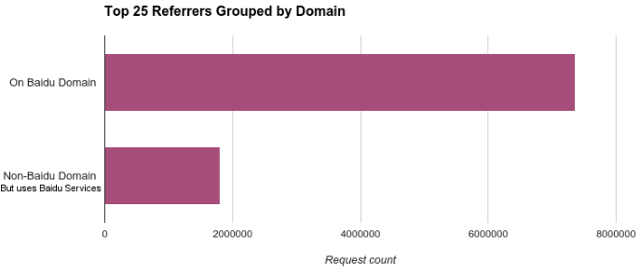
What Domains Had Code Injected?
Most common: pos.baidu.com
Baidu is fourth most-visited site globally

Slide 40
Active Probing

Slide 41
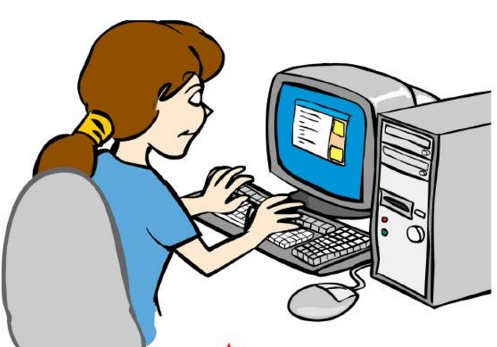
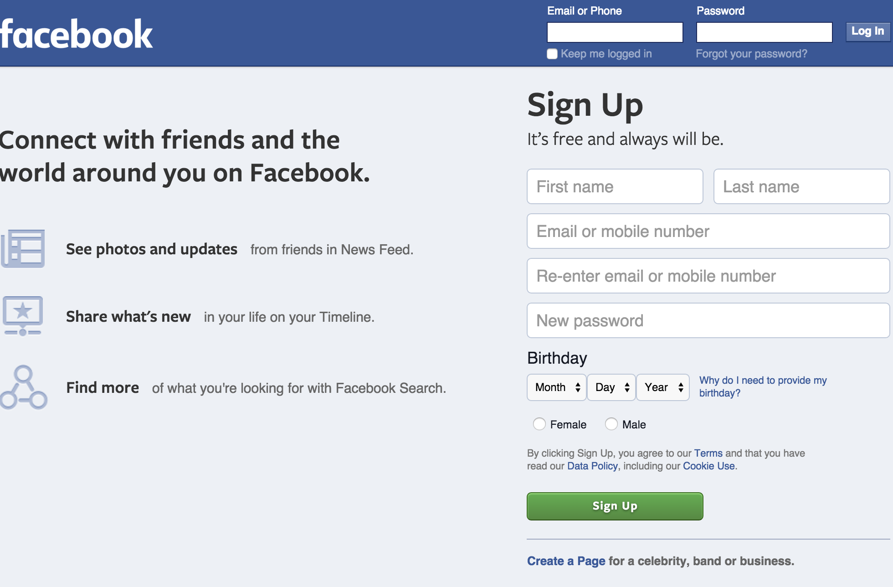

Circumventing Internet Censorship Using Proxies
Internet
Web servers
Notes:
For many of us accessing web servers such as Facebook.com is just typing it in web browsers and there you go.

Slide 42
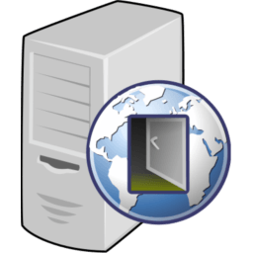
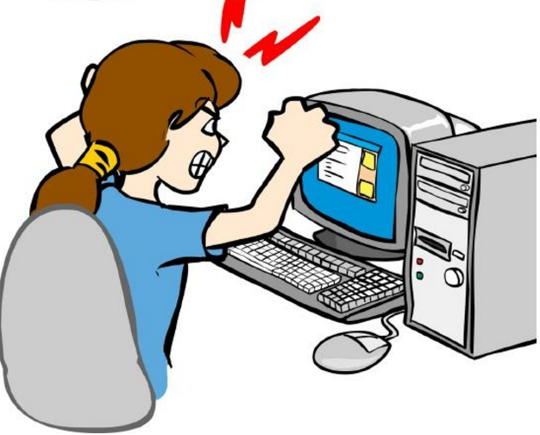


Circumventing Internet Censorship Using Proxies
How do governments find these proxies?
Not everyone can connect to all web servers
Many use proxy servers to circumvent censorship
Governments are getting smarter at detecting proxy servers
Internet
Proxy server
Web servers
Notes:
In this talk our goal is to answer how these governments find these proxies?

Slide 43
How GFW Discovers Hidden Circumvention Servers*
We focus on the GFW and Tor
GFW is a sophisticated censorship system
Tor has a long history of being used for circumventing government censorship
*How the Great Firewall discovers hidden circumvention servers Roya Ensafi, David Fifield, Philipp Winter, Nick Feamster, Nicholas Weaver, and Vern Paxson (IMC2015)
Notes:
To answer to these questions systematically with great details we aim to focus on Chinese censorship apparatus a.k.a GFW and figure how they find these hidden circumvention servers especially tor hidden relays a.k.a Tor Bridges.
We chose GFW because not only it has the sophisticated censorship system, but also, other suppressive regimes have followed their steps for their national firewall implementation. It wasn’t long back ago when China allegedly signed a contract to help one country in their firewall implementation.
We believe our detailed understanding of how GFW is implemented/architected can help Circumvention tool designers to have a realistic view of national firewall capabilities and therefore help them design tools that are sustainable and practical.
We focus on Tor because there has been an interesting decade long arms race between Tor and GFW. Let me give you an overview which covers a necessary background to understand our work.

Slide 44


Censorship Arms Race: GFW vs. Tor
Use public Tor network to
circumvent GFW
Time
Notes:
When Tor network gained puplarity.
When GFW realized more than thousands citizens are circumvention their censorship using Tor public network, they went after Tor. They basically download all the relays and block them all.

Slide 45
Censorship Arms Race: GFW vs. Tor
Use public Tor network to
circumvent GFW
Download consensus and block relays
Time
Notes:
When GFW realized more than thousands citizens are circumvention their censorship using Tor public network, they went after Tor. They basically download all the relays and block them all.

Slide 46
Censorship Arms Race: GFW vs. Tor
Use public Tor network to
circumvent GFW
Download consensus and block relays
Time
Introduce private bridges, whose distribution is rate-limited
Notes:
To deal with this issue, Tor developers came up with the idea of Tor Bridge DB, that is a list of Tor relays that are not publicly available therefore no government can EASILY find them and blacklist them.

Slide 47
Censorship Arms Race: GFW vs. Tor
Use public Tor network to
circumvent GFW
Download consensus and block relays
Time
Introduce private bridges, whose distribution is rate-limited
Use DPI to detect Tor TLS handshake
Notes:
Soon after GFW realized that instead of searching for all the relays(proxy servers) they can watch for them by monitoring their citizen’s traffic, So they added DPI box to their infrastructure specifically to detect Tor traffic using fingerprinting.

Slide 48
Fingerprinting the Tor TLS Handshake
TLS handshake is unencrypted and leaks information
Tor’s use of TLS has some peculiarities
X.509 certificate life times
Cipher suites
Randomly generated server name indication (e.g., www.6qgoz6epdi6im5rvxnlx.com)
GFW looks (at least) for cipher suites in the TLS client hello
Notes:
As it turns out, Fingerprinting Tor TLS handshake is not a big deal. First, as you all know, TLS handshake is unencrypted and second Tor TLS handshake has some peculiarities that make it easy to fingerprint.

Slide 49
Censorship Arms Race: GFW vs. Tor
Use public Tor network to
circumvent GFW
Download consensus and block relays
Time
Introduce private bridges, whose distribution is rate-limited
Use DPI to detect Tor TLS handshake
Introduce pluggable transports to hide the handshake such as obfs2, obfs3
Notes:
At first tor project tried to adapt it to look like Firefox talking to apache server.
Tor developers realized this and thus fix this problem by obfuscating Tor traffic to make it less conspicuous.They came up with the concept of pluggable transport which its goal is to wrap the tor traffic in another layer so DPI cannot detect it.

Slide 50
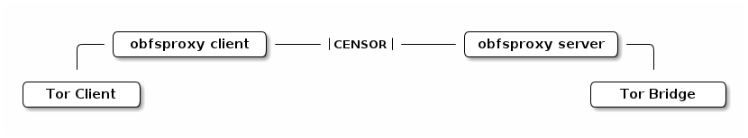
Tor Pluggable Transport
Pluggable transports are drop-in modules for traffic obfuscation
Many modules have been written, but we focus on
obfs2 (First deployed module)
First 20 bytes can be used to detect Tor traffic.
obfs3 (obfs2’s successor)
Makes Tor traffic look like a uniformly random byte stream
Notes:
The first pulggable transport was called obfs 2 and basically obfuscates Tor traffic to looks like a uniformly random byte stream. However, it is implemented in a way that by looking at the first 20 bytes , GFW can detect Tor traffic with high confidence.
So Tor fixed this in obfs3 which makes it harder for reliably distinguish Tor traffic. This means detecting tor traffic out of all these look like random streams would lead to lots of false positives.

Slide 51
Encryption Reduces Blocking Accuracy
Detection of pluggable transports is uncertain
Implies false positives → collateral damage
GFW added active probing to complement the DPI fingerprinting
Notes:
The cost of false positive is much more for national firewalls, especially GFW. Because of huge number of Internet users in China any collateral damage is easily detectable.
However, GFW dealt with this probabilistic detection in a smart way, they added active probing to complement their DPI.

Slide 52
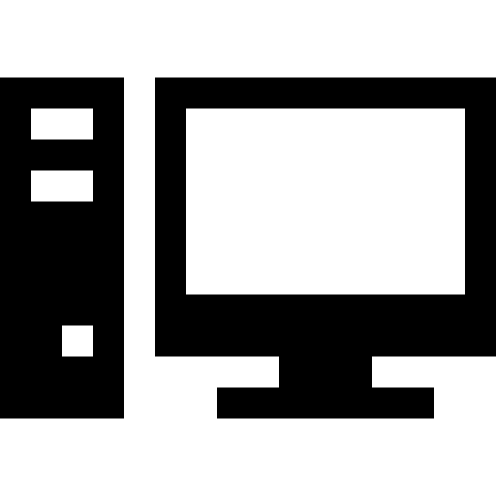

How Does GFW Block Tor Hidden Circumvention Servers?
Network monitoring (e.g., switch mirror port)
DPI for suspicious traffic (e.g., cipher suite)
Actively probing server to verify suspicion
Blocking server
Server in Germany
Block server
Client in China
TLS connection
Tor handshake
Tor handshake
Active prober
Notes:
First GFWs monitor network traffic, and use the DPI to detect suspicious traffic, then they active probe the server by speaking the protocol to verify suspicion if they succeed in establishing the protocol handshake, they block the server
We knew very less about active probing and there where so many unanswered questions.
They lunch a short live probe and speak the protop

Slide 53
Censorship Arms Race: GFW vs. Tor
Use public Tor network to
circumvent GFW
Download consensus and block relays
Time
Introduce private bridges, whose distribution is rate-limited
Use DPI to detect Tor TLS handshake
Introduce pluggable transports to hide the handshake such as obfs2, obfs3
Use DPI + Active probing
Notes:
Tor developers realized this and thus fix this problem by obfuscating Tor traffic to make it less conspicuous.They came up with the concept of pluggable transport which its goal is to wrap the tor traffic in another layer so DPI cannot detect it.

Slide 54
Questions about Active Probing
Implementation: how does it block?
Architecture: how is a system added to China’s backbone?
Policy: what kind of protocols does it block?
Effectiveness: what’s the degree of success at discovering Tor bridges?
Notes:
We soon found out that beside the two blog posts and Philipp’s FOCI paper that provide evidence on this phenomena. There are no other works.

Slide 55
Data: Shadow Infrastructure
Shadow Infrastructure
Clients in China repeatedly connected to bridges under our control
3 months
Packet captures of both the clients and the bridges
EC2-Vanilla
CERNET Network
EC2-Obfs2
EC2-Obfs3
EC2-Vanilla
EC2-Obfs2
Unicom ISP
EC2-Obfs3
Amazon AWS
Clients in China
Notes:
Given the questions the most natural way to answer them is to check what a Chinese user does and experiences and because previous studies suggested users in different ISPs being treated differently in China, we acquired VPS in both CERNET and UNICOMM, the biggest ISP in china. We installed private bridges (Tor vanilla, obfs2, and obfs3) using amazon EC2. Then for 3 months we regularly every five minutes connect from our clients to the bridges. We called this dataset a shadow dataset.

Slide 56
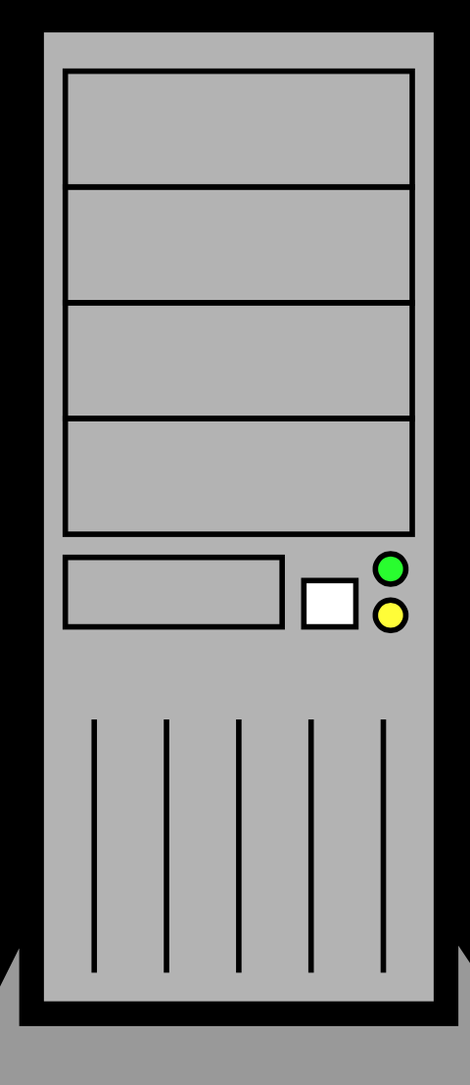

Data: Sybil
Redirected 600 ports to Tor port
Client in China connects to 600 ports
22 hours
Pcap files of both the client and the relay
Sybil Infrastructure
30000
.
.
30300
.
. 30600
Client in China
Vanilla Tor
Forwarding 600 ports to Tor port
Notes:
This dataset answered to some questions we had but not all, so we designed another experiments with the goal of attracting was many active probers. Previous studies showed that GFW is only blocking Tor ORPort so if we run another series on other ports it is accessible. We used this property for our benefit, we forwarded 600 ephermal ports to ORport, so in the eye of the censor our client in China is establishing connection to more than 600 Tor bridges. This experiment lasted 2 hours and we call this dataset a sybil dataset.

Slide 57
Data: Server Logs
Web server that also runs a Tor bridge located in US
Web server logs dating back to Jan 2010
Server Log Analysis
Notes:
We also used David’s 5 years server application logs in order to answer to questions such as when active probing might started. He has been running Tor bridges in the background but he doesn’t have pcaps for Tor port.

Slide 58
Data
Sybil Infrastructure
Shadow Infrastructure
30000
.
.
30300
.
. 30600
EC2-Vanilla
CERNET Network
Client in China
EC2-Obfs2
EC2-Obfs3
Vanilla Tor
Forwarding 600 ports to Tor port
EC2-Vanilla
EC2-Obfs2
Unicom ISP
EC2-Obfs3
Server Log Analysis Application logs of a web server that also runs a Tor bridge since 2010.
Amazon AWS
Clients in China
Notes:
We also used David’s 5 years server application logs in order to answer to questions such as when active probing might started. He has been running Tor bridges in the background but he doesn’t have pcaps for Tor port.

Slide 59
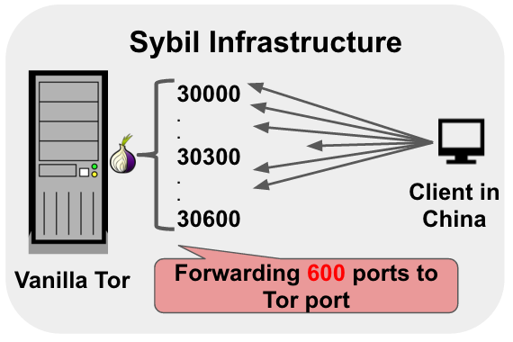
How to Distinguish Probers from Genuine Clients?
Detecting probers in Sybil dataset is easy
Probers:
Visited our vanilla Tor bridge after our client established connections
Originated from China
For the other datasets, we adopt an algorithm
If the cipher suite is in the TLS client hello => Vanilla bridge probes
If the first 20 bytes can reveal Obfs2 => Obfs2 bridges probers
...
Notes:
Well I am sure you are excited to know how we differentiate propers from genuine clients,
Guess what, we fingerprint the probers.
We carefully looked into pacp files and search for patterns layer by layer. Starting by IP layer. Previous research on GFW showed TTL for packets from GFW are weird and limited between 45,51. We observed the same thing for the active probers.

Slide 60
How Many Unique Probers?
Using Sybil, Shadow and Log dataset: 16,083 unique IP addresses
Shadow
135
3 months
Log 14,802
20
2
Sybil 1,090
~ 5 years
GFW’s famous IP: 202.108.181.70
89
22 hours
Notes:
now that we know how GFW finds this proxy servers, and we collected all these cool datasets. what did we learn?
Using these 3 datasets, we learned that GFW rarely use same IP for active probing. We found more than 16000 IPs unique IP addresses which belonged to more than 250 subnets in china. That means we cannot just block the list of active probers to protect discover of our proxy servers. In details we found 158 active prober IPs in shadow datasets from 6 EC2 bridges over 3 months, we found more than 1000 IPs in sybil dataset that was running less than 2 hours and more than 14000 in logs.
158 IP addresses in the Shadow dataset → During 3 months
1,182 in the Sybil → Only in 22 hours
14,912 in the Log → Over the past 5 years
111 of the addresses appear in two of the three datasets
Just one—— appears in all three

Slide 61
Where Are the Probers Coming from?
Reverse DNS suggests ISP pools
adsl-pool.sx.cn
kd.ny.adsl
online.tj.cn
Majority of probes come from three autonomous systems
ASN 4837, 4134, and 17622
Shadow
135
Log 14,802
Sybil 1,090
Notes:
how do we define probes?
first, where are all these probes coming from? they are all from china, but what’s their IP addresses?
if we know their addresses, we could just blacklist them, right?
came up with heuristics to extract probes from our dataset.

Slide 62
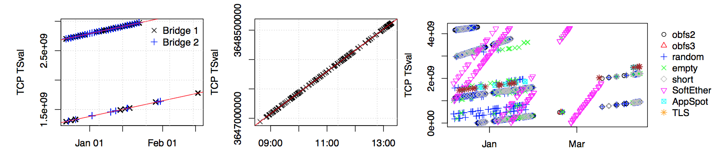
Fingerprinting Active Probers
TCP layer → TSval
TSval intercept: (rough) system uptime
GFW likely operate a handful of physical probing systems
Shadow exp. with 158 Prober IPs
Sybil exp. with 1,182 Prober IPs
Log dataset with 14,912 Prober IPs
Notes:
We found more interesting stuff at TCP layer especially among TCP time stamp values. We plot the TCP TSval values for all our probers from our datasets. The TSval intecepts suggest there are handful physical probing systems with different system uptime…
Handful liner pattern

Slide 63
Can We Fingerprint Active Probers?
TCP layer → ISN
TCP uses 32-bit initial sequence numbers (ISNs)
Protects against off-path attackers
Attacker must guess correct ISN range to inject segments
Every SYN segment should have random ISN
Notes:
Another neat pattern at TCP layer is related to ISN values. To protect TCP connections from on path attackers, initial sequence numbers must not be guessable by an attacker. Modern operating systems use strong randomness to select ISNs. But Initial sequence numbers of SYN segments sent by probers, despite the probers coming from different IP addresses is, a clear linear pattern manifests.

Slide 64
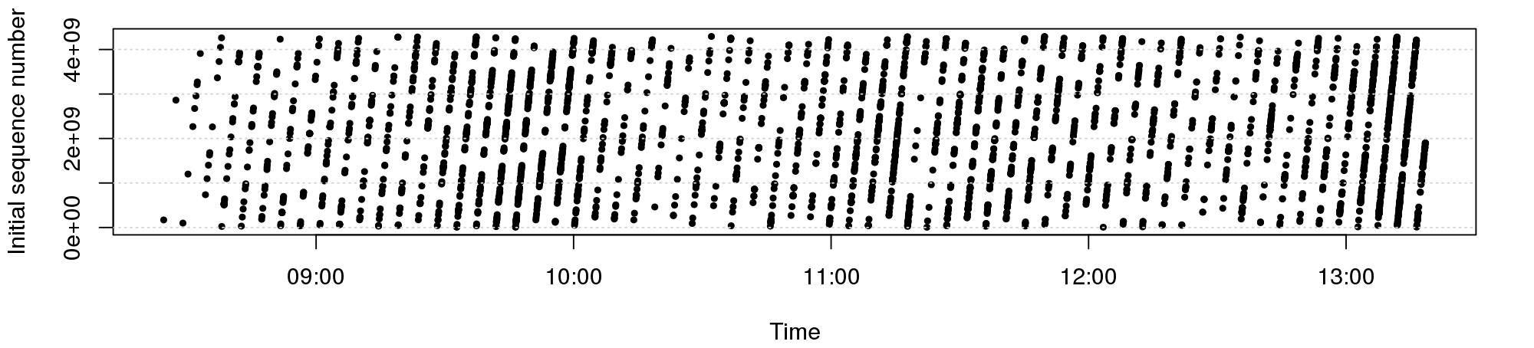
Fingerprinting Active Probers
TCP layer → ISN
TCP uses 32-bit initial sequence numbers (ISNs)
Protects against off-path attackers
Attacker must guess correct ISN range to inject segments
Every SYN segment should have random ISN
Notes:
Another neat pattern at TCP layer is related to ISN values. To protect TCP connections from on path attackers, initial sequence numbers must not be guessable by an attacker. Modern operating systems use strong randomness to select ISNs. But Initial sequence numbers of SYN segments sent by probers, despite the probers coming from different IP addresses is, a clear linear pattern manifests.

Slide 65
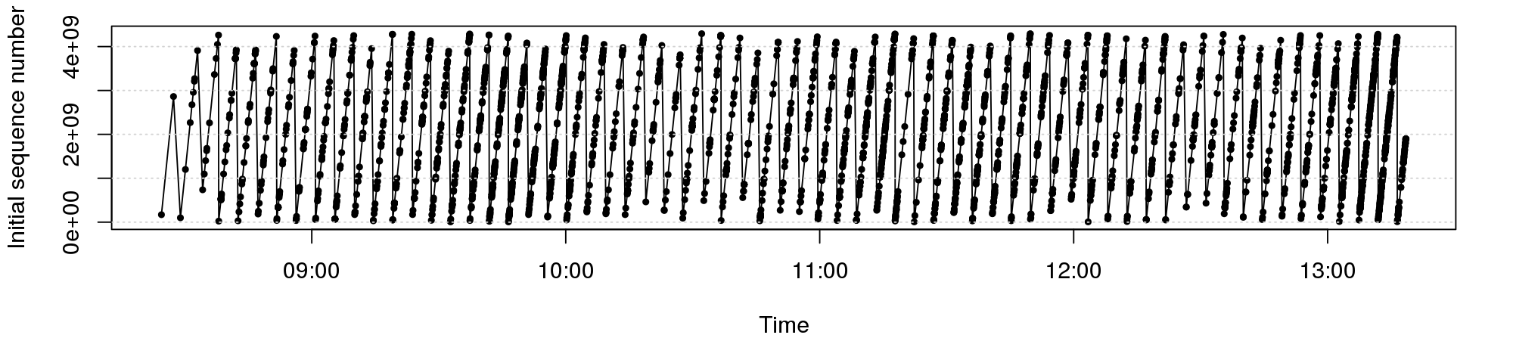
Fingerprinting Active Probers
TCP layer → ISN
TCP uses 32-bit initial sequence numbers (ISNs)
Protects against off-path attackers
Attacker must guess correct ISN range to inject segments
Every SYN segment should have random ISN
Notes:
Another neat pattern at TCP layer is related to ISN values. To protect TCP connections from on path attackers, initial sequence numbers must not be guessable by an attacker. Modern operating systems use strong randomness to select ISNs. But Initial sequence numbers of SYN segments sent by probers, despite the probers coming from different IP addresses is, a clear linear pattern manifests.

Slide 66
What do These Patterns Mean?
Active probing connections leak shared state
ISNs, TSval, source ports, ...
GFW likely operates only few physical systems
Thousands of IP addresses are controlled by central source
Does does not seem like off-the-shelf networking stack
User space TCP stack?
Notes:
Exactly the slide texts

Slide 67
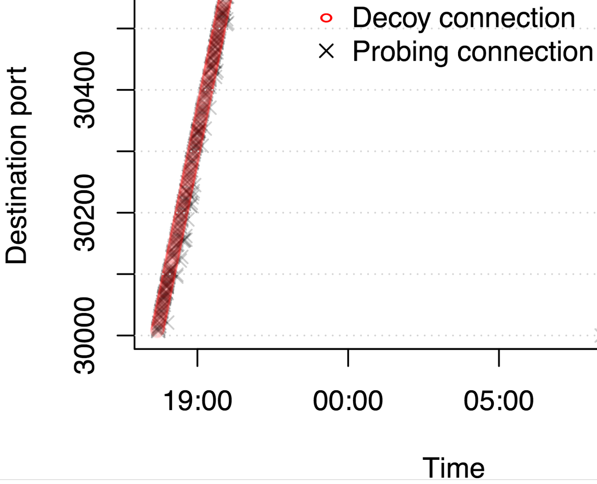
How Quickly Do Active Probes Show Up?
Sybil dataset shows that system now works in real time
Median delay between Tor connection and subsequent probing connection is ~500ms
1,182 distinct probes showed up in 22 hours
Notes:
Previous work suggested every 15 mins and GFW might have probed servers in batches, we showed active probing happens in realtime.
First, 56% of all probing connections arrived after less than one second (median 552 ms).

Slide 68
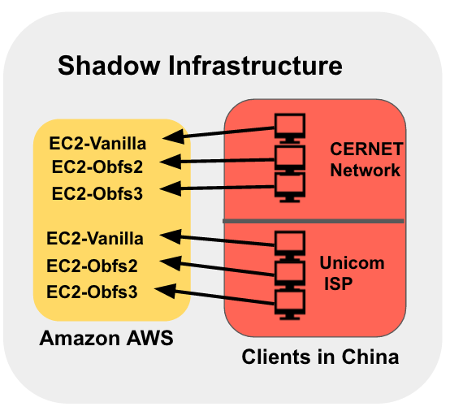
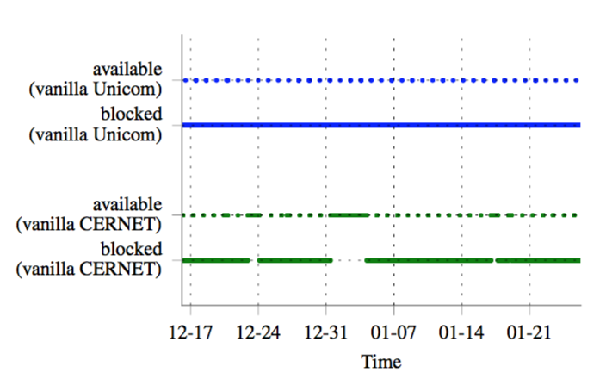
Is Active Probing Effective?
Tor clients succeed in connecting roughly every 25 hours
Might reflect implementation artifact of GFW
obfs2 and obfs3 (~98%) were almost always reachable for clients
Notes:
We looked at 3 months data we collected by establishing Tor handshake every 5 min from Chinese VPS to our EC2 Tor bridges.
obfs2 and obfs3 (~98%) were almost always reachable for clients
Tor vanila was almost alway blocked except roughly every 25 hours. We expect that is implementation artifact for example many commercial firewalls “fail open” when their access control lists are being updated

Slide 69
Active Probing: Summary
Our results show that the active probing system
Makes use of a large amount of IP addresses, clearly centrally controlled
Operates in real time
Probes Vanilla, Obfs2, and Obfs3 Bridge
Notes:
In paper: Can detect at least five circumvention protocols

